Slide 2

Agenda
Project objectives
Software architectures
Live Demonstration
Hardware suggestion
Future scope and further development
Q&A

Slide 3
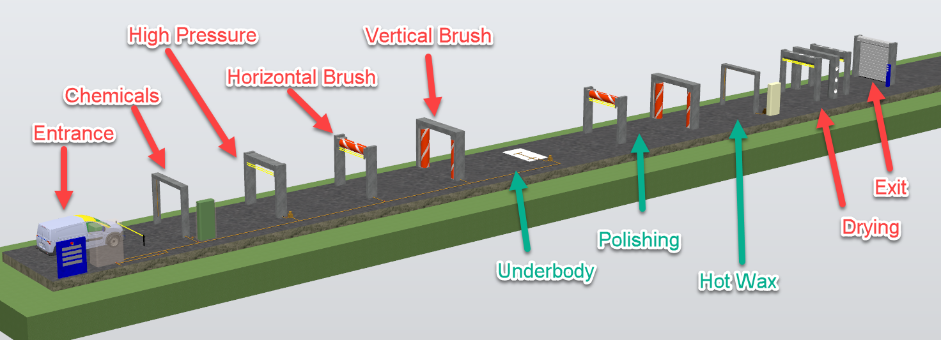
Project Objectives
Develop software for an automated car wash system.
Select suitable hardware for the system.
Provide two versions in different price categories.
Create a universal and modular software design.

Slide 4
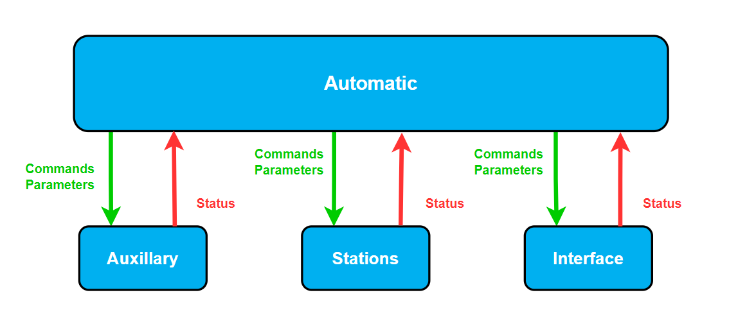

Software Arcitechture
Hand-over for future development
Top-Down communication
Structure adapted for version control

Slide 5

Overdue tasks
File handling for successful programs.
Extend alarm handling

Slide 6
Live Demonstration
Compact Version:
Premium version:

Slide 7
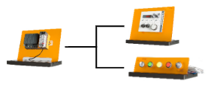
Live Demonstration
Compact Version:
Premium version:

Slide 8
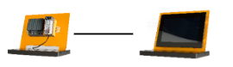
Live Demonstration
Compact Version:
Premium version:

Slide 9
Suggested Hardware Solution
Module | Description | Compact Version | Premium Version
X20DO6321 | Digital Output | 8 | 14
X20DO9320 | Digital Output | 1 | 2
X20DO2623 | Digital Output | 4 | 5
X20DI6371 | Digital Input | 5 | 7
X20AI2622 | Analog Input | 2 | 4
X20AO4622 | Analog Output | 1 | 1
X20DC1196 | Counter | 1 | 1
X20AIB744 | Analog Input for strain gauges | 2 | 2
X20BC0083 | Bus node interface | - | 11
8LVA13.B1030D000-0 | Motor | 4 | 4
80VD100PD.C000-01 | Servo drives | 2 | 2
X20PS9400 | Power supply module | 5 | -

Slide 10
Future Scope and Further Development
Hardware design
Horizontal brushes: Distance between entry sensor and roll should be larger to avoid collision.
Brushes must be able to close fully to clean front and back.
Sensors: Missing sensor specification for hardware.
Software development
Clean 2 cars simultaneously
Minimize the operating resources
Prolong lifetime of components
Application and support from B&R

Slide 12
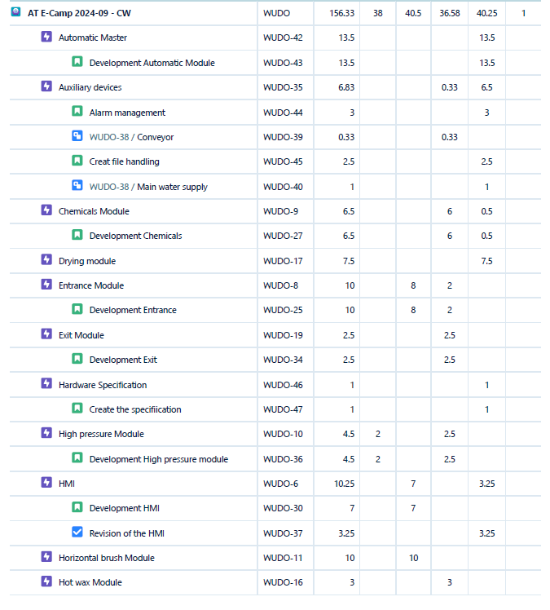
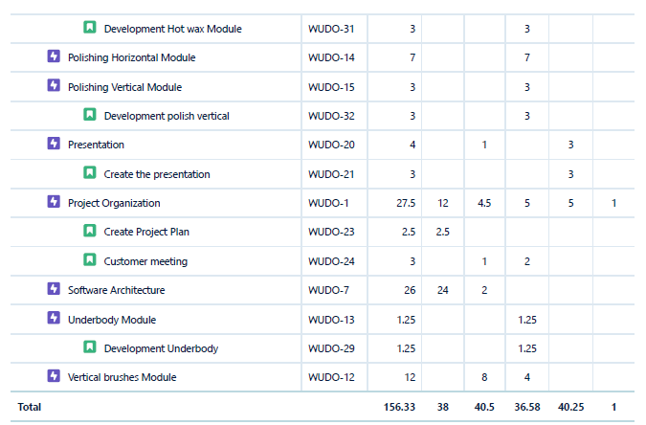
Project Management

